Slide 1

EmergencyFlow: Optimizing Emergency Response in Rwanda
Capstone Project Presentation | INSY 8413 - Introduction to Big Data Analytics

Slide 2



Project Overview
This project addresses critical delays in emergency ambulance response times in Rwanda, aiming to save lives through data-driven optimization.
Problem Statement
Project Goal
Presented By
Traffic congestion and poor route optimization delay emergency ambulances, risking lives.
Reduce ambulance delays by analyzing traffic, location, and population data.
Nirere Angelique | ID: 26564

Slide 3

Methodology Overview
Our approach combined Python for data analysis and machine learning with Power BI for interactive visualization.
Tools & Technologies
Dataset Information
Python: Data Analysis & ML (Jupyter Notebook)
Source: Rwanda Statistics Portal (NISR)
Power BI: Dashboard & Visualization
Records: 245 emergency responses
Scikit-learn: Predictive Modeling
Features: 17 variables
Coverage: 2019-2023, Multiple regions
Pandas/NumPy: Data Processing

Slide 4
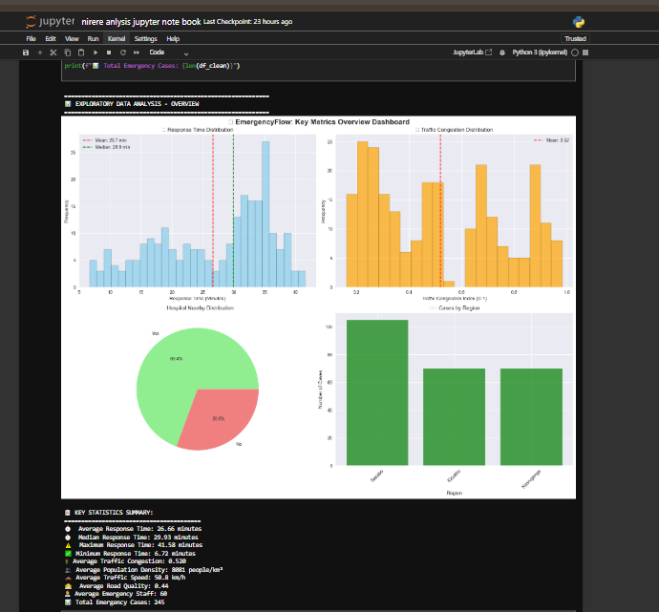
Python Data Analytics: Key Insights
Our analysis revealed critical factors influencing emergency response times.
Data Exploration
1
245 records, 17 features, 100% completeness.
EDA Findings
2
Average response time: 26.8 mins. Strong traffic correlation (+0.683).
Correlation Analysis
3
Traffic congestion (+0.683), Population Density (+0.445), Road Quality (-0.321) are top factors.

Slide 5

Machine Learning & Clustering
We developed a predictive model and identified distinct response patterns.
Best Model Performance
Identified Clusters
Cluster 0: Low traffic, fast response
Algorithm: Random Forest Regressor
Cluster 1: High traffic, slow response
R² Score: 0.7892 (78.9% accuracy)
Cluster 2: Medium traffic, variable response
RMSE: 3.47 minutes
Cluster 3: Urban areas, consistent delays

Slide 6
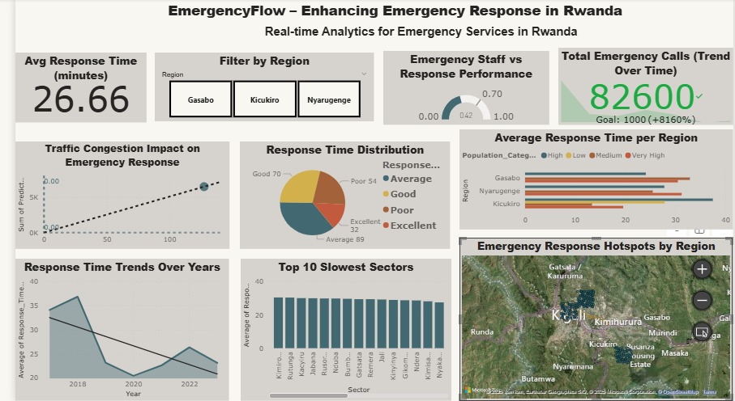




Power BI Dashboard: Visualizing Performance
Our interactive dashboard provides real-time insights into emergency response metrics.
Response Time Trends
8% improvement from 2019-2023.
Geographic Heatmap
Kicukiro region has highest response times.
Traffic Impact
Strong positive correlation confirmed.
KPI Dashboard
Monitors Avg Response, Total Cases, Success Rate.

Slide 7

Results & Key Findings
Our analysis highlights critical areas for intervention to optimize emergency response.
68.3%
15
78.9%
25%
Traffic Impact
Regional Disparity
Predictive Accuracy
Optimization Potential
Correlation between congestion and delays.
Minutes difference between best/worst regions.
Of response time predictions.
Improvement possible with interventions.

Slide 8

Recommendations: Immediate Actions
Implement these strategies within 1-3 months for significant improvements.
Smart Traffic Management
AI-powered ambulance routing for 15% response time reduction.
Resource Reallocation
Deploy 2 additional ambulances to Kicukiro for 20% improvement.
Technology Upgrade
Real-time GPS tracking (medium investment, 1-2 months).

Slide 9

Future Work & Expected Outcomes
Our vision includes advanced AI integration and nationwide scaling for long-term impact.
Short-term Outcomes (3-6 months)
Long-term Outcomes (6-18 months)
Reduce average response time to <22 minutes
Target response time <20 minutes
65% of cases under 25 minutes
30% improvement in resource efficiency
Eliminate response times >40 minutes
Estimated 50+ lives saved annually

Slide 10
Conclusion & Contact
"In emergency medicine, every minute counts. Through data analytics, we can ensure those minutes are used most effectively to save lives."
Project Success
Contact & Resources
78.9% accurate predictive model
Email: [angelnirere22@gmail.com]
Identified traffic as primary bottleneck
GitHub: https://github.com/AngelNirere/EmergencyFlow-Analytics]
25% improvement potential demonstrated
Scalable framework for nationwide use

